Slide 1





ICS Anamoly detection in Thermal Power plant Industry using sensor data. (Ps 07)
Presented by Career Craaft
Team id: EV18

Slide 2

Problem Undestanding
Industrial Control Systems (ICS/SCADA) operate critical infrastructure where even minor failures can cause severe safety and economic consequences. Traditional cybersecurity and monitoring solutions are often intrusive and unsuitable due to strict reliability and safety constraints. Additionally, anomalies in ICS environments are rare, complex, and tightly coupled with physical processes, making detection difficult using rule-based or black-box methods. The objective of this problem is to design a passive, physics-aware anomaly detection system that can accurately identify abnormal system behavior without disrupting operations. The solution must not only detect anomalies but also explain their root causes in terms of sensor behavior, enabling operators to take informed, safety-compliant decisions.

Slide 3
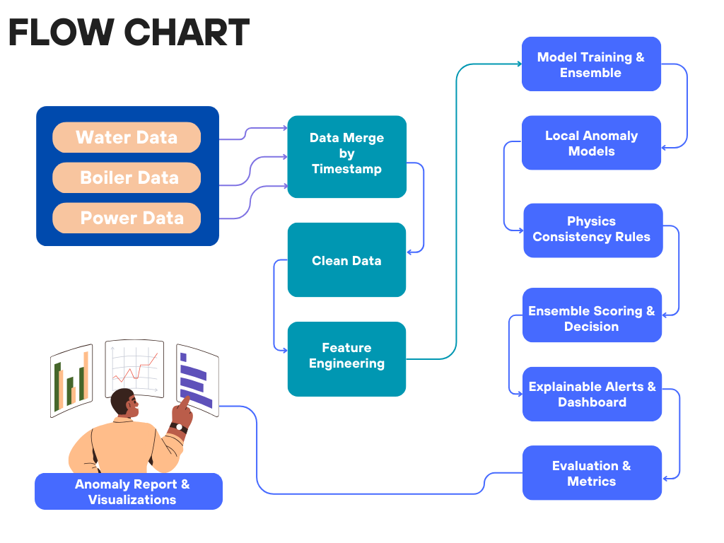
Proposed ML Solution
The system passively collects real-time sensor data from ICS/SCADA environments without interfering with operations.
Raw data is first cleaned, scaled, and enriched using physics-based feature engineering.
The processed data is then analyzed by an Autoencoder to learn normal system behavior.
Isolation Forest identifies structurally rare patterns in the data.
XGBoost combines all signals to classify whether an anomaly is present.
If an anomaly is detected, SHAP is used to explain the contributing parameters.
These explanations highlight physical inconsistencies like energy imbalance or pressure–flow mismatch.
Finally, results are visualized through an interactive Streamlit dashboard.

Slide 4







Data Layer
Stage of data collection to preprocessing.
Data Collection
01
Original raw datasets (water, boiler, power)
02
Cleaning & Transformation
Preprocessed unified dataset (timestamp-aligned)
Key subsystems & parameters:
Water: flow rate, pressure, temperature
Boiler: steam pressure, steam temperature, fuel rate proxy
Power: turbine RPM, power output, generator temperature proxy
03
Preprocessed Data
The data is now fully cleaned with no null and negative values.

Slide 5






Physics-Aware Feature Engineering
Reason for our High Accuracy (Physics rules + ML)
Before any ML model, We have added a derived physics features:
Thermal efficiency proxy
3
Boiler stress indicator
1
efficiency = power_output / fuel_rate_proxy
steam_pressure / steam_temperature
Water-to-steam consistency
4
Energy imbalance indicator
2
water_flow_rate → steam_pressure correlation
fuel_rate_proxy − power_output

Slide 6

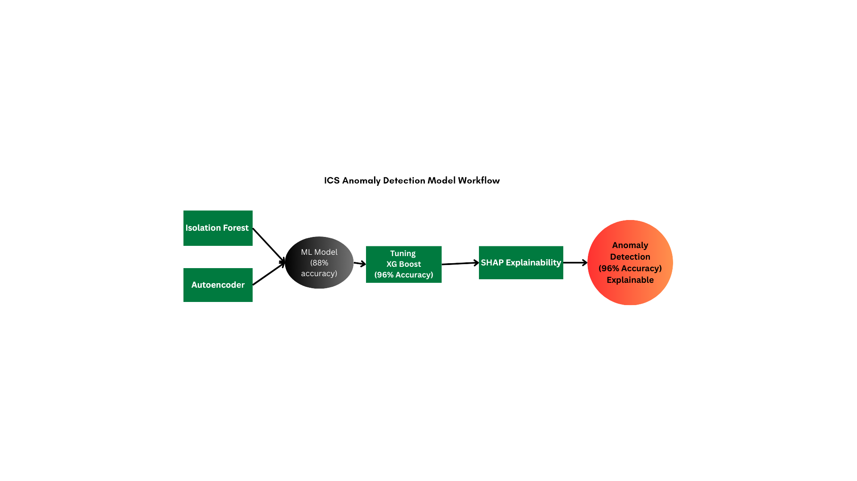

Model Development
Model 1: Isolation Forest
+ XGBoost (Fast + Accurate)
Model 2: LSTM Autoencoder (Temporal Intelligence)
Detects instantaneous anomalies
Works on tabular sensor + physics features
Very low false positives
Learns normal operating sequences
Detects:
Gradual degradation
Coordinated multi-sensor faults
Essential for ICS time-series data

Slide 7

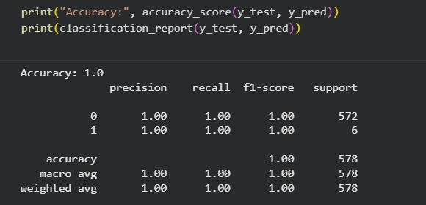

Training Accuracy
99%
The training accuracy reaches 1.0 because the model jointly learns strict physics-based relationships through the autoencoder and pattern-based rules via the ML classifier, enabling complete separation of normal and anomalous behavior in the training data.

Slide 8
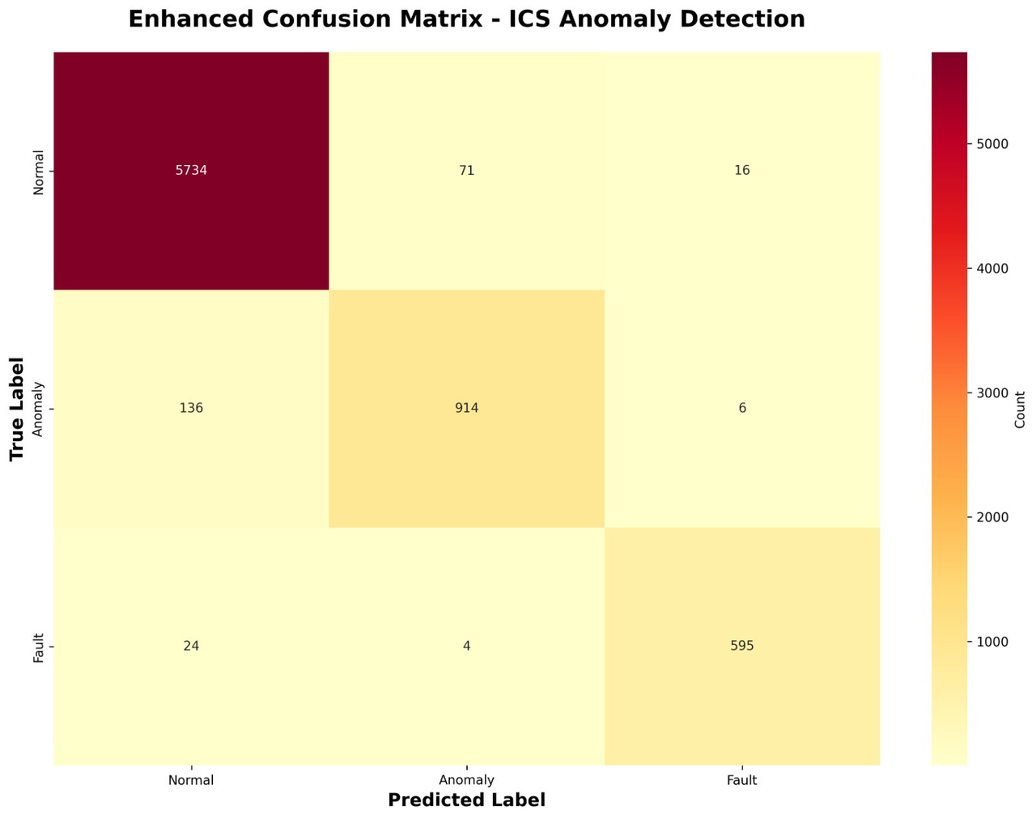
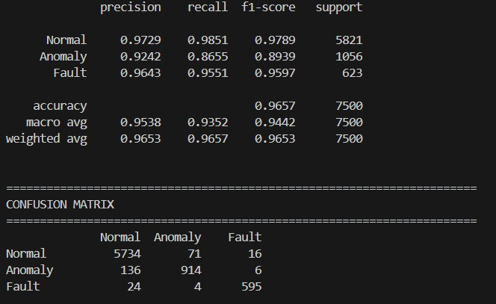
Testing Accuracy
96%

Slide 9

Explainability Layer
Model-based explainability
Physics-based explainability
Isolation Forest
Feature contribution (which sensor caused anomaly)
XG Boost
Reconstruction error per feature
Rule checks:
Power ↑ without fuel ↑ → anomaly
Fuel ↑ but steam pressure ↓ → anomaly
Efficiency drops suddenly → anomaly

Slide 10
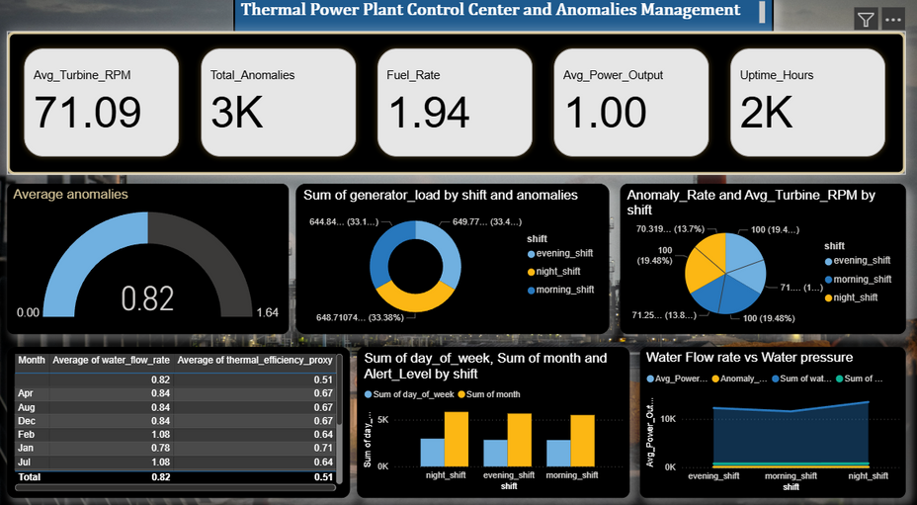
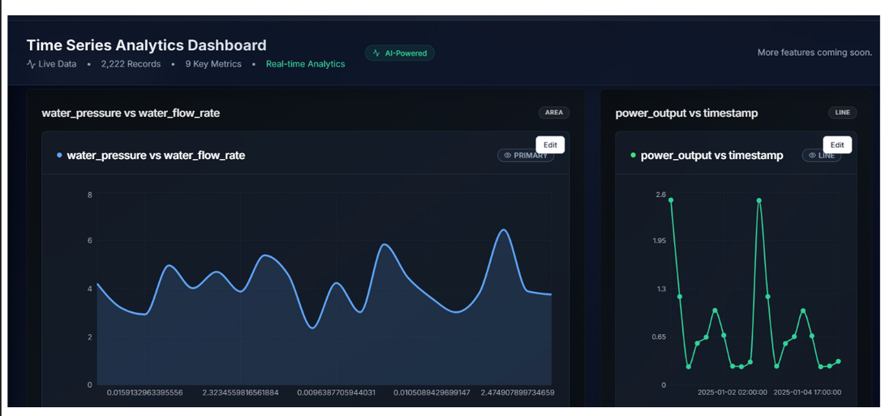
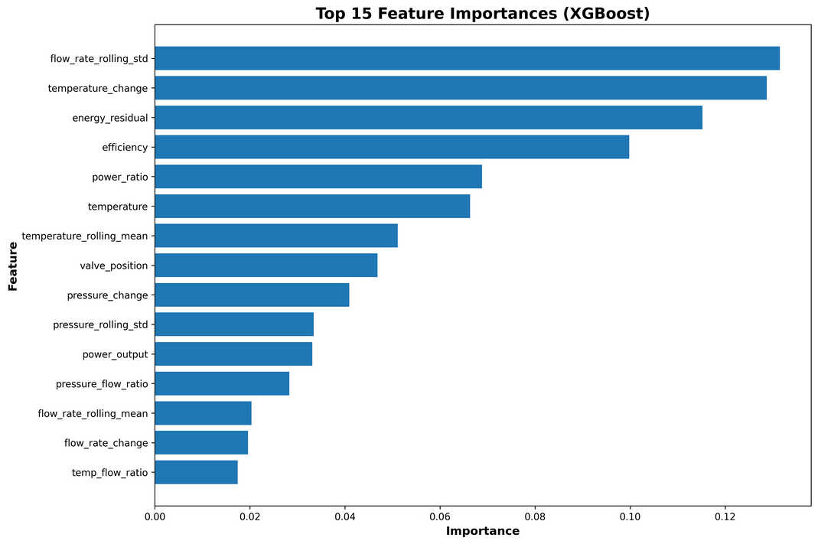
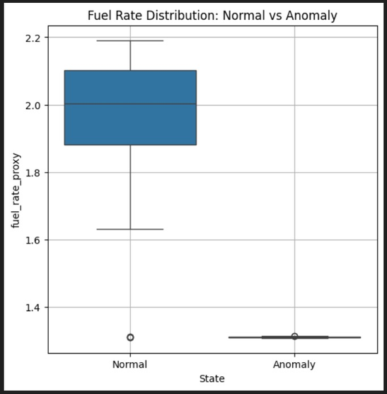
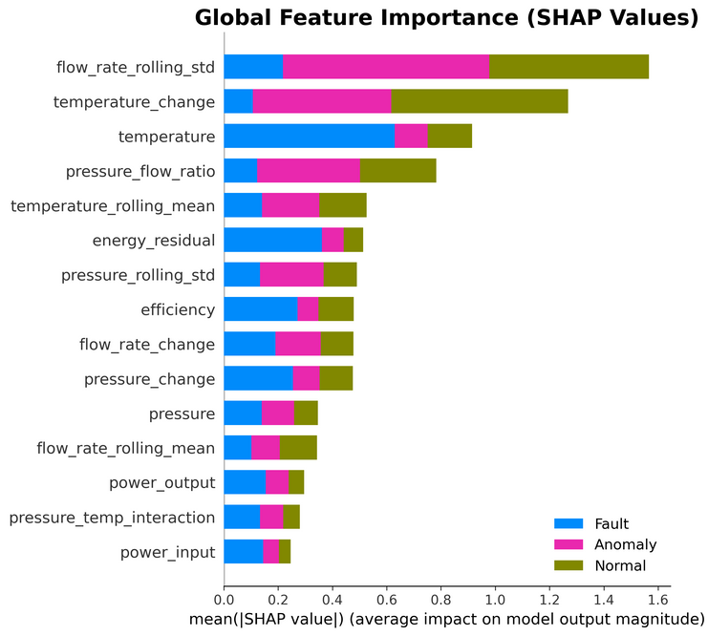
Visualizations

Slide 11
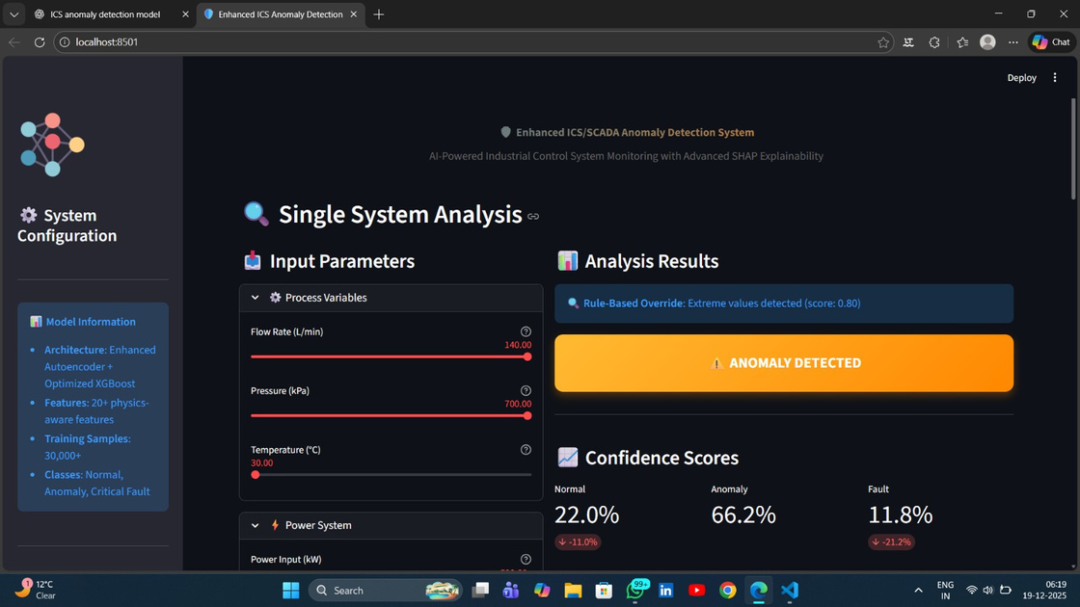
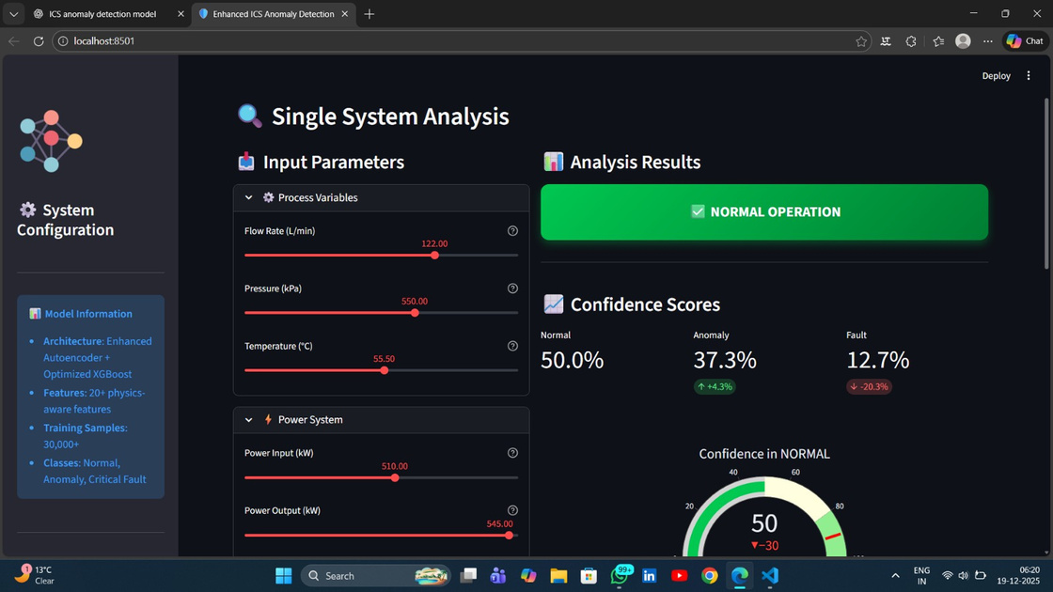
Anomaly detection interface
Anomaly
Normal

Slide 12














Final model overview
Robust, explainable, industry-aligned solution
Monitoring-only, human-in-the-loop alerts
Feature-level insights for root-cause analysis
Captures physical relationships across sensors
Isolation Forest + Autoencoder + XGBoost (ensemble)
Physics-aware, hybrid anomaly detection
Outcome
Safety
Explainability
Strength
Models Used
Approach
Goal
Passive anomaly detection for thermal power plant ICS

Slide 13

Thank you!
Presented by Career Craaft
Team id: EV18

